Slide 1
REDCap Governance Meeting
April 6, 2015

Slide 2
Review of Past Governance Meetings
July 30, 2013
Introduction to REDCap
Finalize Membership Body
Laid out need for Appropriate Use Policy
November 12, 2013
Finalized Appropriate Use Policy documents
Finalized auditing plan
Introduce ideas for training series
Review plans for administration and maintenance of 3 RC instances
Update on REDCap website and project tracker

Slide 3
Today’s Agenda
Quick review infrastructure and management
Quick review of Appropriate Use Policy
Reasoning behind a new support contract
REDCapCon 2014 review
New business
Sustaining REDCap long-term
Opening REDCap to wider community of users
Unveil blueprints to new OU Clinical Data Warehouse

Slide 4
Infrastructure and Management
Three REDCap instances:
BBMC Box- production instance managed by BBMC and primarily used by Peds colleagues
Enterprise Box- a production instance managed by the OSCTR BERD Core and available to all
Development Box- testing and development instance jointly managed by BBMC & BERD
BBMC box funded through Peds grant and contracts monies; Enterprise and Dev Boxes funded through OSCTR funds
BBMC and BERD management teams collaborate and coordinate on high level issues (e.g., upgrading reqs) but production boxes operate somewhat independently

Slide 5
Appropriate Use Policy: Highlights
Scope:
All researchers wishing to use REDCap for managing clinical research data or REDCap Survey for collecting study participants’ responses on-line.
Purpose:
To protect patient/participant privacy and confidentiality while assisting researchers in conducting biomedical and behavioral research.
Policy
Any Authenticated User has a right to access REDCap, review public databases, and create a new database or modify a database for which corresponding authorization has been granted.
Any new user is strongly encouraged to make an appointment with the BBMC or BERD Core for an introduction to REDCap (about 1 hour) before attempting to create a new database in REDCap.
In the case of data regarding patients or participants of OUHSC and its affiliates, all users must comply with HIPAA Privacy and Security Policies and Procedures for PHI, FERPA, and all other human subjects information privacy and security protections.
IRB Auditing
The BBMC will perform nightly audits of user access for each REDCap instance.
Upon request, the IRB will have access to an audit report of IRB approved use

Slide 6
New and Improved Training Opportunties
Thomas Wilson designed 3-part training series
101: The Basics for any and all RC users
201: Intermediate course for project owners
301: Advanced course for admins
101 and 201 materials available on the website: https://bbmc.ouhsc.edu/redcap/bbmc/REDCap.html
OSCTR provided FTE support for 2014 trainings
50 new users trained
Funds needed to keep the momentum going in 2015

Slide 7
New Support Contract Required
An OU Legal stipulation for approved use and wide publicity
We’ve outgrown the old contract which was never intended to service an enterprise application
April of 2014 update resulted in BBMC crash
New Contract Highlights
Hardware and software specs uniformly distributed
More explicit details on IT, BBMC, and BERD admin responsibilities
New monthly update schedule and step-by-step process
New backup and recovery testing procedures
New risk assessment performed and detailed
Cost of new support contract ~$3,280 per box, per year

Slide 8
REDCapCon 2014 in Park City, Utah
Three OU attendees last year
Highlights
Adding customization hooks to REDCap to enhance functionality
Will Beasley is a member of the national Plugin committee
New Training Committee is born
Thomas Wilson accepted co-chair honors
Automated IRB Forms within REDCap
New Offline REDCap technology introduced
Examples of clinical data warehouses the utilize REDCap
Business model series on sustaining growth

Slide 9
Literate Programming Patterns and Practices for Continuous Quality Improvement (CQI)
Will Beasley, Thomas Wilson, & David Bard University of Oklahoma Health Sciences Center Pediatrics Dept, Biomedical & Behavioral Methodology Core (BBMC)
REDCap Con
Sept 23, 2014
Notes:
Hi I’m Will from the University of Oklahoma, along with Thomas Wilson & David Bard. I’d like to describe some of the approaches we’ve employed when connecting REDCap with our statistical modeling and dynamic reporting workflows.

Slide 10
Interacting with the REDCap API using the REDCapR Package
Thomas Wilson, Will Beasley, David Bard University of Oklahoma Health Sciences Center Pediatrics Dept, Biomedical & Behavioral Methodology Core (BBMC)
REDCap Con
Sept 23, 2014
Notes:
Good morning. My name is Thomas Wilson. Today I am going to be discussing the use of an R package, REDCapR to interact with REDCap’s API.
In the previous presentation, Will discussed an architecture design for literate programming patterns and practices. At OUHSC, we utilize this architecture structure using multiple components. Among those components are REDCap, the R programming language, and the REDCapR package.
Although, this structure is what we use, you can easily see that the components can be employed as stand alone pieces.
However, I think you will be able to see the advantage of combining these pieces to your research practices.

Slide 11
Business Model Sessions
Eleven different models presented
All fund 1+ FTE to administer REDCap
Majority funded using CTSA grants
Some used combination of institutional funds + fee-for-service
General advice
Offer free support for REDCap at least in short-term until reaching saturation
User growth is exponential, so get prepared early

Slide 12
The Word is Out
Looking for feedback on opening REDCap to other campuses
Tulsa already using our system
Norman next?
Outside institutions have shown interest
Need governance policy on opening up the system beyond OU
Thoughts and reactions???

Slide 13
Blueprints to an OU Clinical Data Warehouse
Zsolt Nagykaldi has been advocating for years
Conversation changed when EMR came asking for assistance
OU CDW plans constructed (Beasley, Nagykaldi, Bard)
Starting with small no. of pilot projects
OSCTR support 0.5 FTE for CDW programmer
Need to devise a CDW governance body – volunteers needed!!!
Product review with IT now complete for seminal architecture

Slide 14
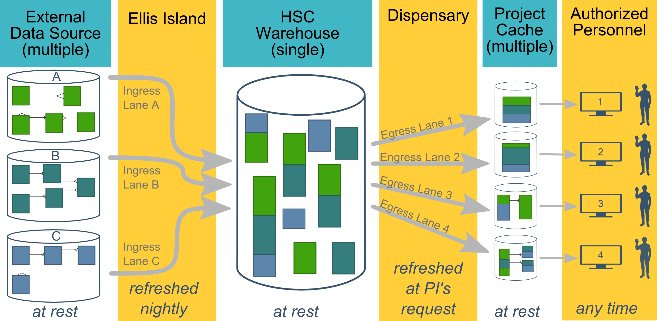
CDW Architecture

Slide 15
Long-term Vision

